Slide 1


Maddy Stores
Dashboard

Slide 2
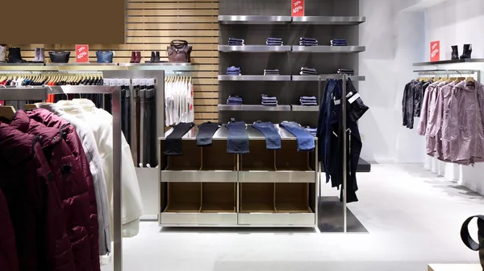
Project Objective
To develop a comprehensive Maddy Stores dashboard that provides real-time insights into key performance metrics and trends.
Enabling stakeholders to monitor and analyze sales operations effectively in various regions.

Slide 3

Import data to SQL database
Prepare csv file, clean data, checking for unique values, removing null values and empty rows

Slide 4
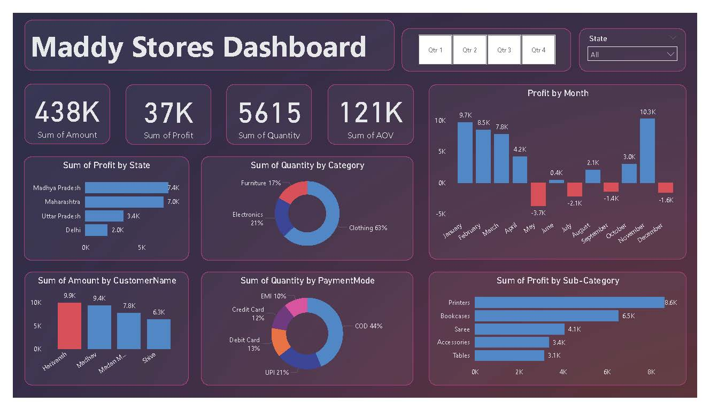

Slide 5
Project Insights
As per state wise analysis we observed that, the profits in state of Madhya Pradesh was the max amongst all.
As per the net profit value on monthly basis we can see a straight surge in profits in month of November which is highest for the year.
Data also showed that Quantity of clothing were mostly sold in maximum number.
People trusted more COD type of payment method, as compared to other payment modes.
Our top Profitable item that was sold was the printer.
Total profits made this year was 37,000.
Total quantity of products that were sold was 5615.

Slide 6
Project Summary
• Developed an interactive dashboard using transaction and customer data from a CSV database, to provide insights.
• Streamlined data processing & analysis to monitor key performance metrics and trends.
• Shared actionable insights with stakeholders based on dashboard findings to support decision-making processes.

Slide 7


Snehal Dhokrat
Check all my repositories on
https://github.com/goofball-argus?tab=repositories
Keep learning n keep growing

